Slide 1
Volunteer Management System http://group.myvnc.com/VMS
Presented by
Team SE18-08S
SE18-T08S - Jan 2012

Slide 2
Agenda
Project Background
High Level Architecture
System Detailed Design
Implementation Strategy
Challenges & Solution
Demo of VMS v1.0
End Project Report
Evaluation & Conclusion
Q & A

Slide 3
Project Background
VMS - Volunteer Management System : web-based solution to facilitate the volunteer & project management process for non-government organization.
Requirements overview:
Volunteer Management –register volunteer, invite to project, request for certificate
Project Management – propose project, manage project members, closure of project
Certificate Management – request, generate and distribute certificate of completion
Administration – authentication and authorization, infrastructure, utility

Slide 4
Agenda
Project Background
High Level Architecture
System Detailed Design
Implementation Strategy
Challenges & Solution
Demo of VMS v1.0
End Project Report
Evaluation & Conclusion
Q & A

Slide 5
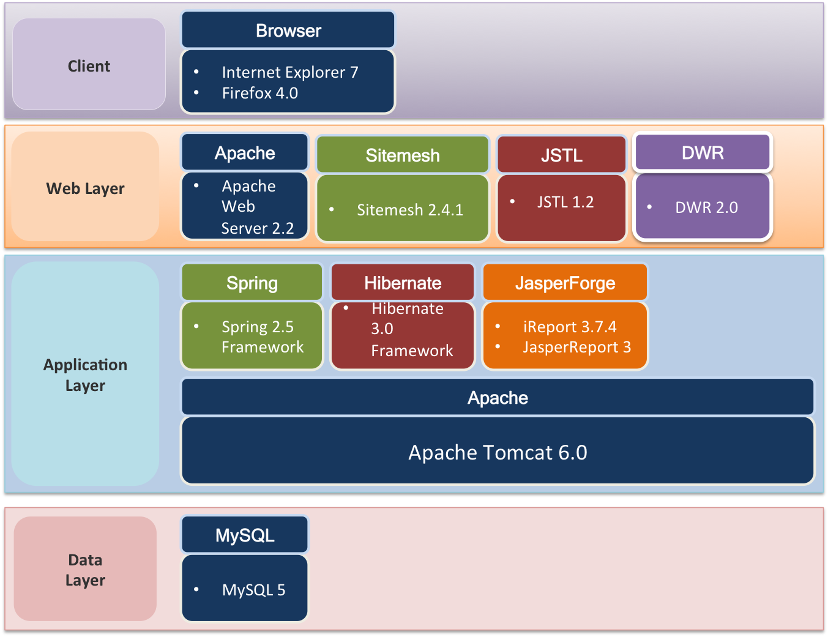
High Level Architecture - 1 System components

Slide 6
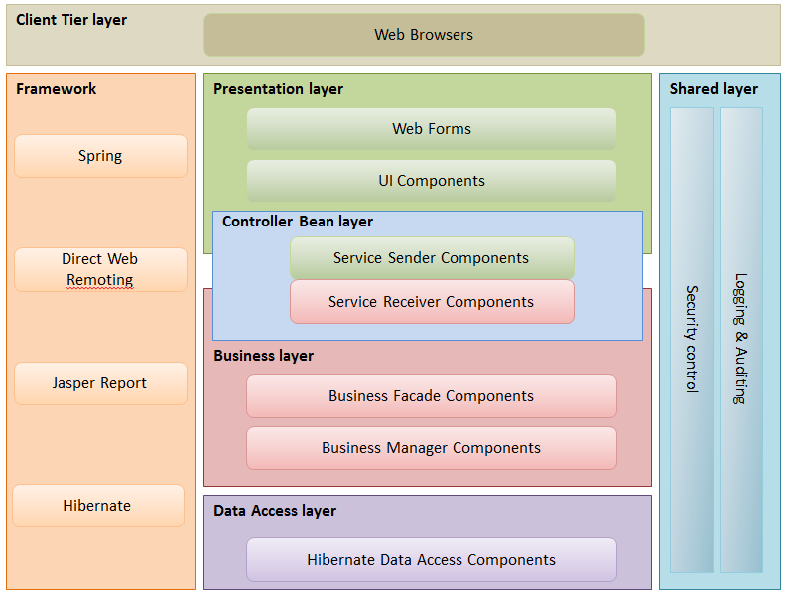
High Level Architecture - 2 Logical Application Architecture

Slide 7
Agenda
Project Background
High Level Architecture
System Detailed Design
Implementation Strategy
Challenges & Solution
Demo of VMS v1.0
End Project Report
Evaluation & Conclusion
Q & A

Slide 8
System Detailed Design - 1
Design Consideration:
Application layer:
Apache Tomcat 6, Spring 2.5 Framework
Data access layer:
MySQL 5.0 - Hibernate 3.0 Framework
Domain entity mapping: Fluent Hibernate syntax
UI layer:
Sitemesh, JTSL
jQuery, jQuery plugins, JavaScript lib
Utility components:
Log4j, JasperReport
Testing:
jUnit, Mockitory

Slide 9
Agenda
Project Background
High Level Architecture
System Detailed Design
Implementation Strategy
Challenges & Solution
Demo of VMS v1.0
End Project Report
Evaluation & Conclusion
Q & A

Slide 10

Implementation Strategy - 1
Development cycle:
Detailed Design
Code implementation
Test / QA
Fix / improvement
Check-in

Slide 11
Implementation Strategy- 2
Build sequence:
Function-based:
Base manager, base service
Infrastructure: Security, Logging, Validation, Common utility
Master data management: CRUD of Project, Volunteer
Use case-based:
Use cases logic
UI development (JSP), JasperReport

Slide 12

Implementation Strategy - 3
Software Configuration Management:
Control board: Project Manager, QA Manager, Team Lead
Control mechanism:
SVN Repository: code check-in, branching, tagging
Database deploy / backup
Application backup to disk
Quality Management:
Perspective review: URS, UCRR review
Peer review (design / code)
Code walk-through
Unit test, SIT

Slide 13
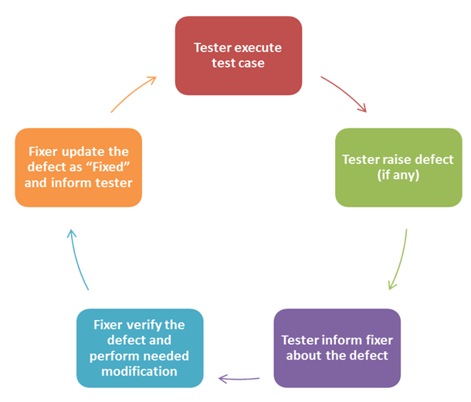
Implementation Strategy - 4
Quality Assurance process
URS → Design test cases → Test activities
Test cycle:

Slide 14
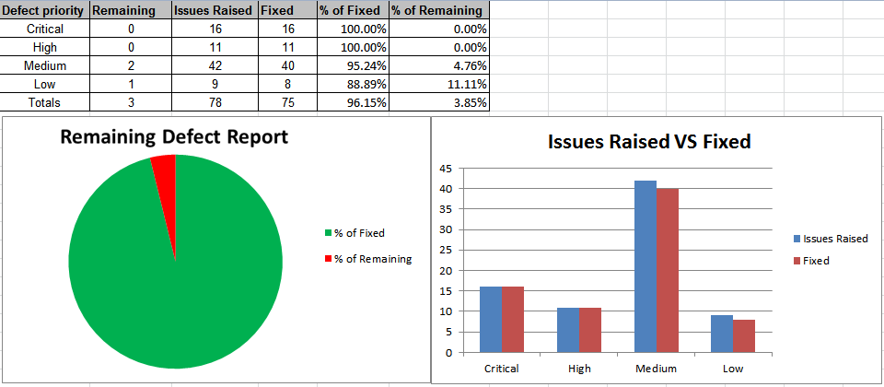
Implementation Strategy - 5
Quality Assurance result:

Slide 15
Agenda
Project Background
High Level Architecture
System Detailed Design
Implementation Strategy
Challenges & Solution
Demo of VMS v1.0
End Project Report
Evaluation & Conclusion
Q & A

Slide 16


Challenges & Solution - 1
Management Challenges : Development of dependent modules:
Infrastructure Utilities: Email, Logging, Access Control
Volunteer Management: Join Project, Request for Certificate
Project Management: Roles Assignment
Solution:
Impact Analysis: prioritized important tasks
Define tasks dependency network: define order of build, focus on parallel development tasks
Rely on Contract / Service interface / Business Façade
Daily code-merge & test

Slide 17
Challenges & Solution - 2
Management Challenges : Fragmented Project Management lead to lack of project status visibility
Slippage by 2 weeks for code implementation due to refactoring needed for non-standard works
Slippage by 1 week for SIT & testing due to delay in implementation
Solution:
Proactive engagement of progress tracking:
Extensive task report, deliverable checklists, meeting minutes
Make-up slippage by:
Extra time spend on weekends / holidays
Early problem report / Surface issue asap.

Slide 18
Challenges & Solution - 3
Technical Challenges : implementation code are not consistent due to late code review
Slippage by 2 weeks due to refactoring
Slippage by 1 week for SIT & testing
Solution:
Proactive engagement of code review:
Extensive code walk through, meeting minutes
Make-up slippage by:
Extra time spend on weekends / holidays
Early problem report / surface issue asap.

Slide 19
Challenges & Solution - 4
Technical Challenges :
Multi-action form causes:
Difficulties in form validation
Error message post-back
Solution:
Perform manual validation over Spring
Saving error message to HttpResponse before post-back

Slide 20
Agenda
Project Background
High Level Architecture
System Detailed Design
Implementation Strategy
Challenges & Solution
Demo of VMS v1.0
End Project Report
Evaluation & Conclusion
Q & A

Slide 21
Demo of Final System
Demo Use Cases:
Register Volunteer Account
Propose Project to Organization
Request to Join Project
Manage Project Role
Give Feedback To Project
Request for Project Certificate

Slide 22
Demo of Final System
Video

Slide 23
Agenda
Project Background
High Level Architecture
System Detailed Design
Implementation Strategy
Challenges & Solution
Demo of VMS v1.0
End Project Report
Evaluation & Conclusion
Q & A

Slide 24
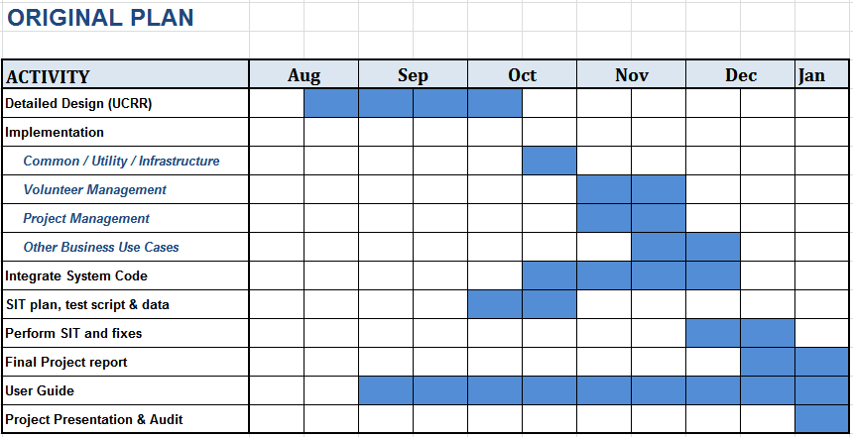
End Project Report

Slide 25
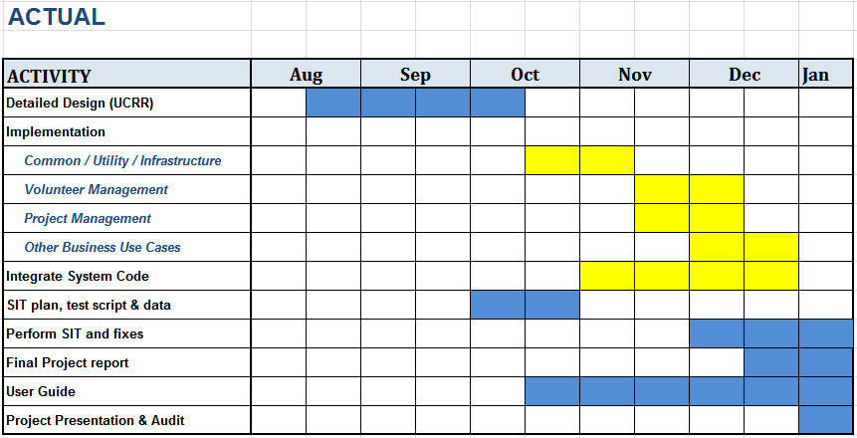
End Project Report
Notes:
Project Plan was reviewed and update mid-way to reflect current progress.
User requirements are reviewed and updated
Project slippage: implementation phases slipped by 2 weeks, SIT slipped by 1 weeks
Mitigation strategy: run extra miles / extra work / active progress checking

Slide 26
Agenda
Project Background
High Level Architecture
System Detailed Design
Implementation Strategy
Challenges & Solution
Demo of VMS v1.0
End Project Report
Evaluation & Conclusion
Q & A

Slide 27
Evaluation & Conclusion
Lessons learnt:
Planning is everything: required for successful delivery
Process management is crucial: Requirement, Analysis, Design, Implementation & Testing procedures must be strictly followed
Quality management: final gateway, quality guardian for project
Active team engagement can solve everything

Slide 28
Evaluation & Conclusion
Further recommendation
New Functionalities :
Itinerary Management (new)
Project Tasks / Calendar (new)
Project Tracking (new)
Technical Points:
Mass email component: email queues
Messaging, Integration point
Exposed API
Integrate with popular platform: Facebook, Twitter…etc.

Slide 29
Agenda
Project Background
High Level Architecture
System Detailed Design
Implementation Strategy
Challenges & Solution
Demo of VMS v1.0
End Project Report
Evaluation & Conclusion
Q & A

Slide 30
Question & Answer

Slide 31
Thank you for a great year !!!
SE18 Team 08S
--------------------
Hnin Nu Aye, Hazel Sr. Business Analyst
Feng Yan Development Lead
Jiang Jifa Test Manager
Liu Peishan Quality Manager
Phung Kim Cuong, Dio Project Manager
Thida Khin Myo Thaung Business Analyst Lead
Zaw Htet Technical Lead

